Slide 1
PADMASHRI DR. VITTHALRAO VIKHE PATIL SAINIK SCHOOL, LONI
CLEANLINESS DRIVE : 19 SEP 23

Slide 2
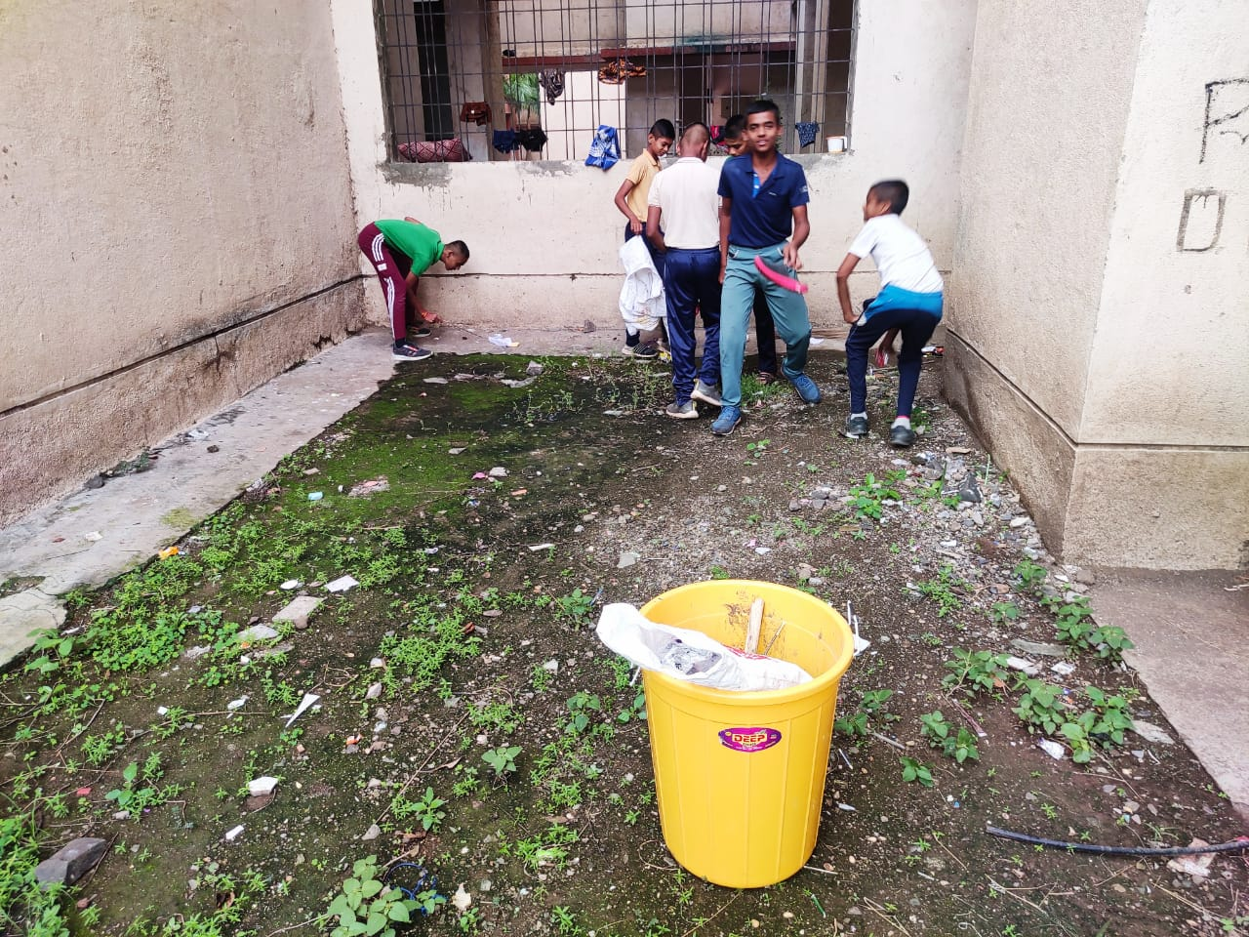
PADMASHRI DR. VITTHALRAO VIKHE PATIL SAINIK SCHOOL, LONI

Slide 3
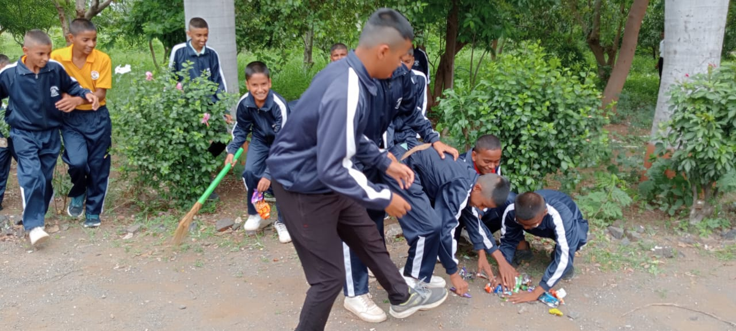
PADMASHRI DR. VITTHALRAO VIKHE PATIL SAINIK SCHOOL, LONI

Slide 4
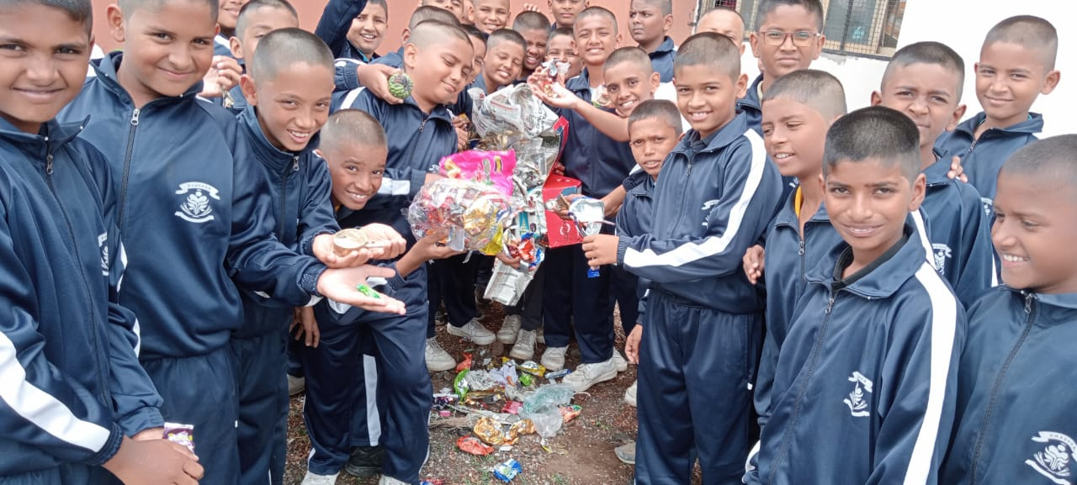
PADMASHRI DR. VITTHALRAO VIKHE PATIL SAINIK SCHOOL, LONI

