Slide 1
PADMASHRI DR. VITTHALRAO VIKHE PATIL SAINIK SCHOOL, LONI
CLEANLINESS DRIVE AT
NEARBY HILL : 21 SEP 23

Slide 2
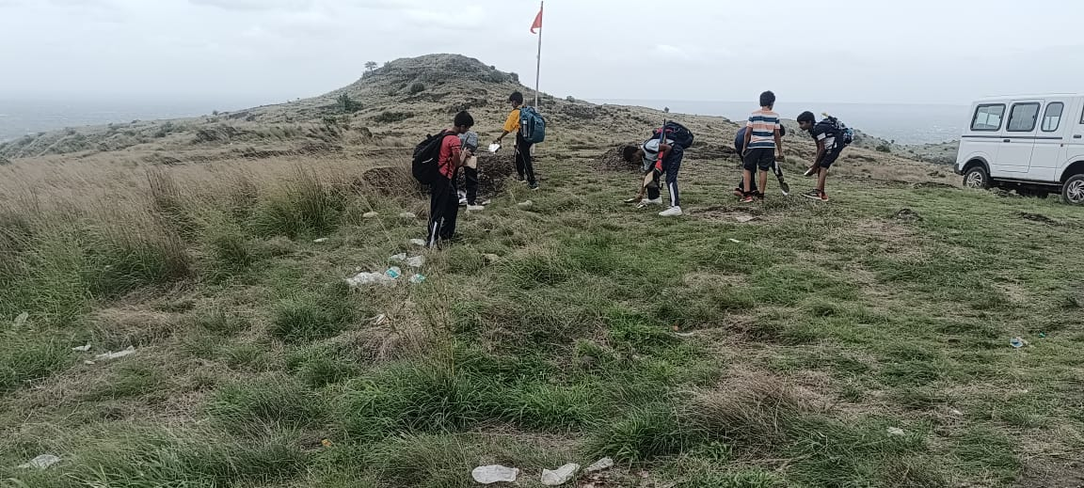
PADMASHRI DR. VITTHALRAO VIKHE PATIL SAINIK SCHOOL, LONI

Slide 3
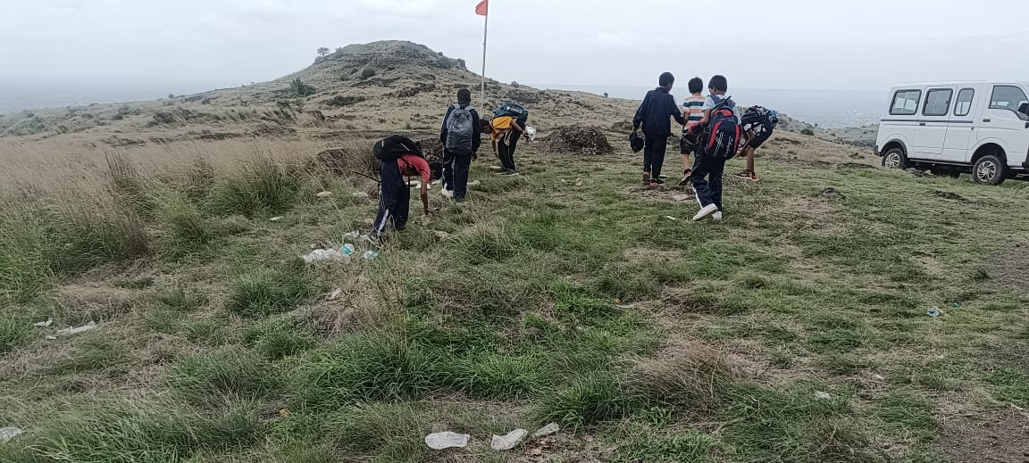
PADMASHRI DR. VITTHALRAO VIKHE PATIL SAINIK SCHOOL, LONI

