Slide 1
PADMASHRI DR. VITTHALRAO VIKHE PATIL SAINIK SCHOOL, LONI
CLEANLINESS DRIVE AT
LOCAL WATER BODY: 22 SEP 23

Slide 2
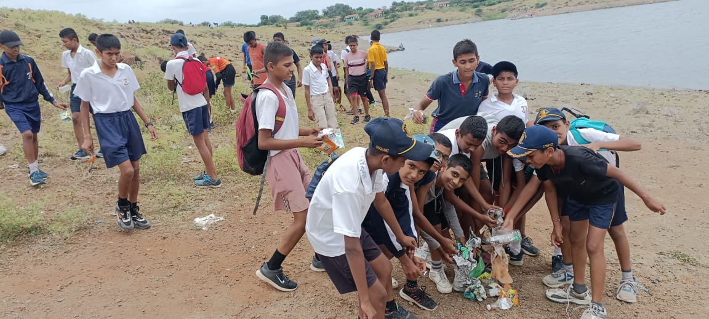
PADMASHRI DR. VITTHALRAO VIKHE PATIL SAINIK SCHOOL, LONI

