Slide 1
PADMASHRI DR. VITTHALRAO VIKHE PATIL SAINIK SCHOOL, LONI
SWACHHATA SKIT : 25 SEP 23

Slide 2
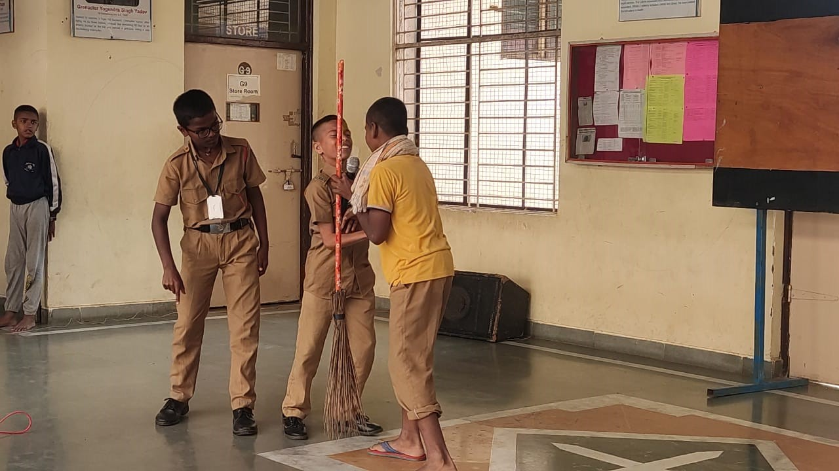
PADMASHRI DR. VITTHALRAO VIKHE PATIL SAINIK SCHOOL, LONI

Slide 3
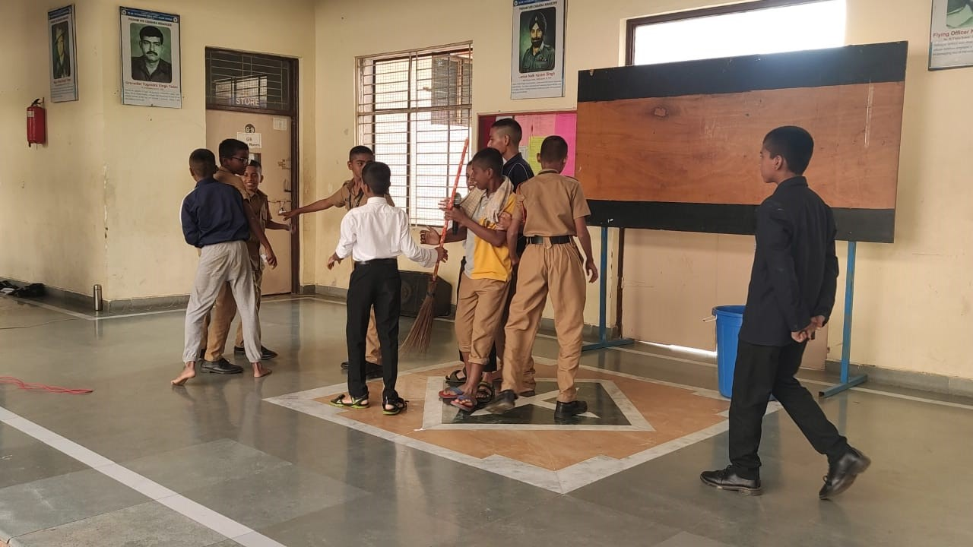
PADMASHRI DR. VITTHALRAO VIKHE PATIL SAINIK SCHOOL, LONI

Slide 4
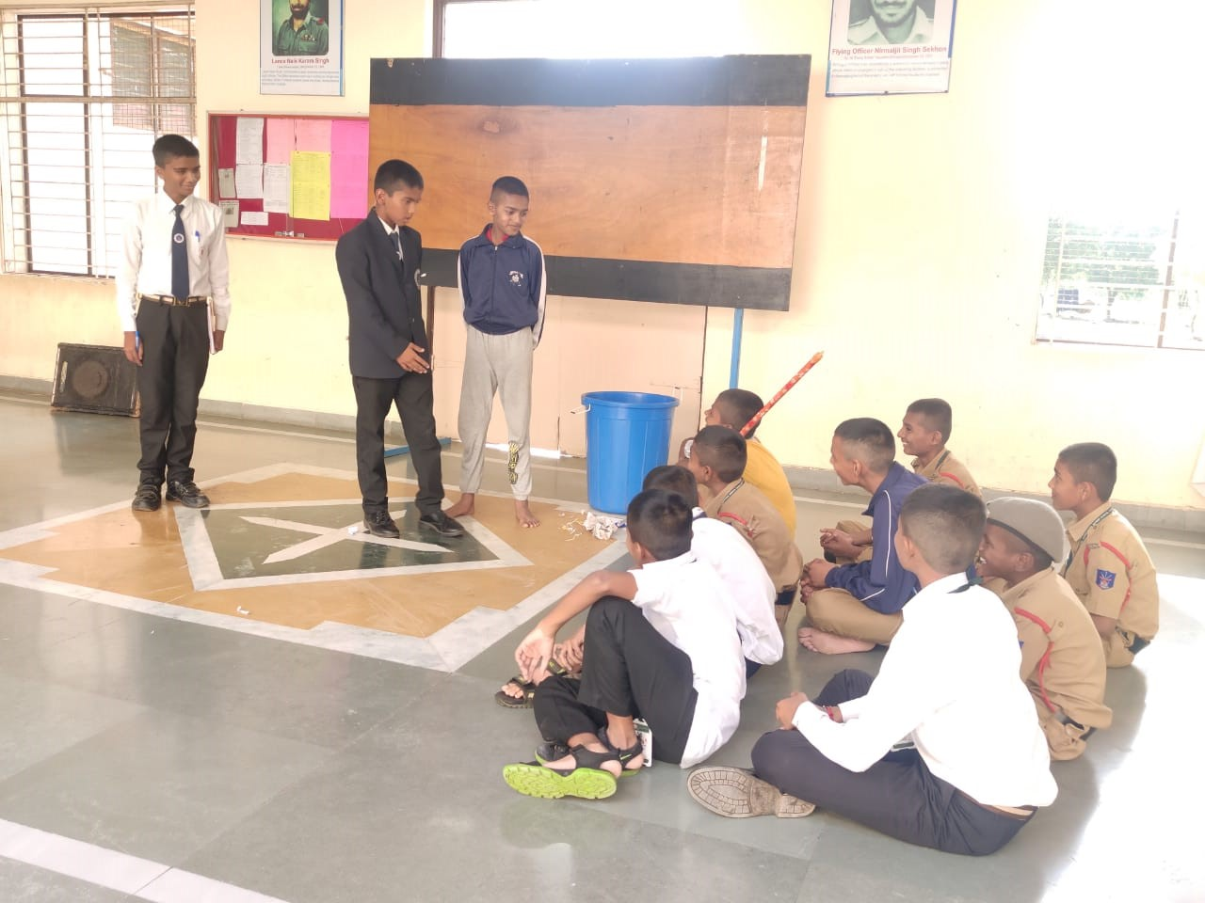
PADMASHRI DR. VITTHALRAO VIKHE PATIL SAINIK SCHOOL, LONI

Slide 5
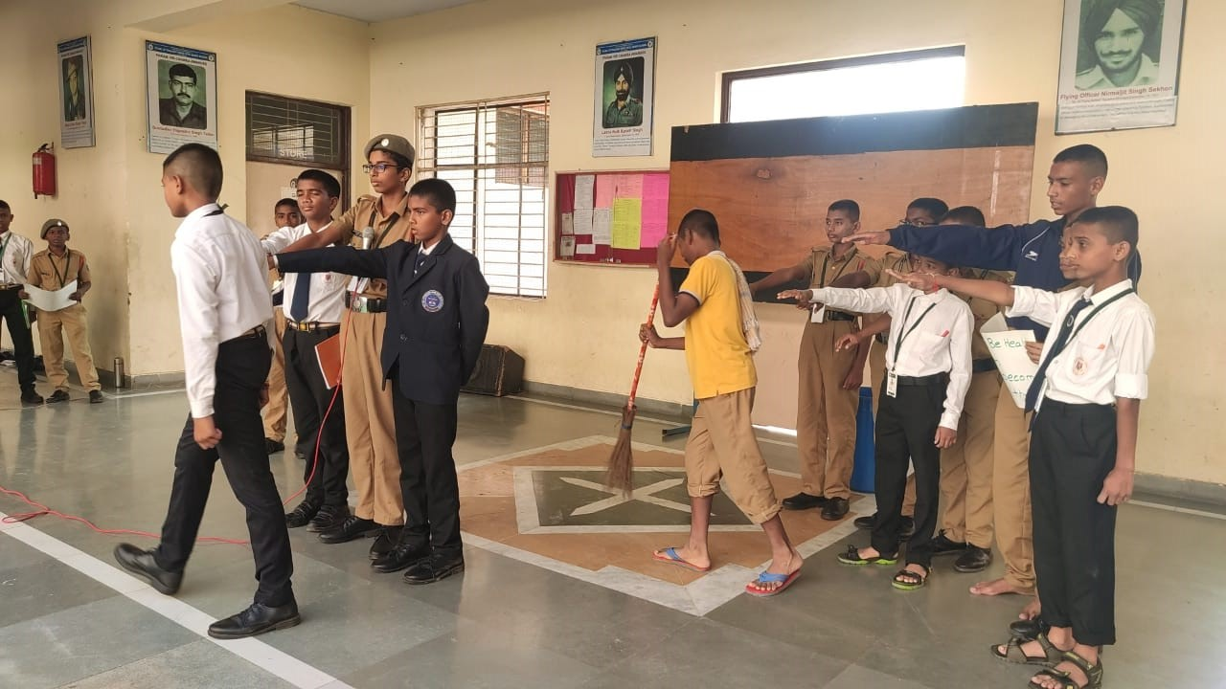
PADMASHRI DR. VITTHALRAO VIKHE PATIL SAINIK SCHOOL, LONI

