Slide 1
PADMASHRI DR. VITTHALRAO VIKHE PATIL SAINIK SCHOOL, LONI
SWACHHATA RALLY AT NEARBY VILLAGE : 28 SEP 23

Slide 2
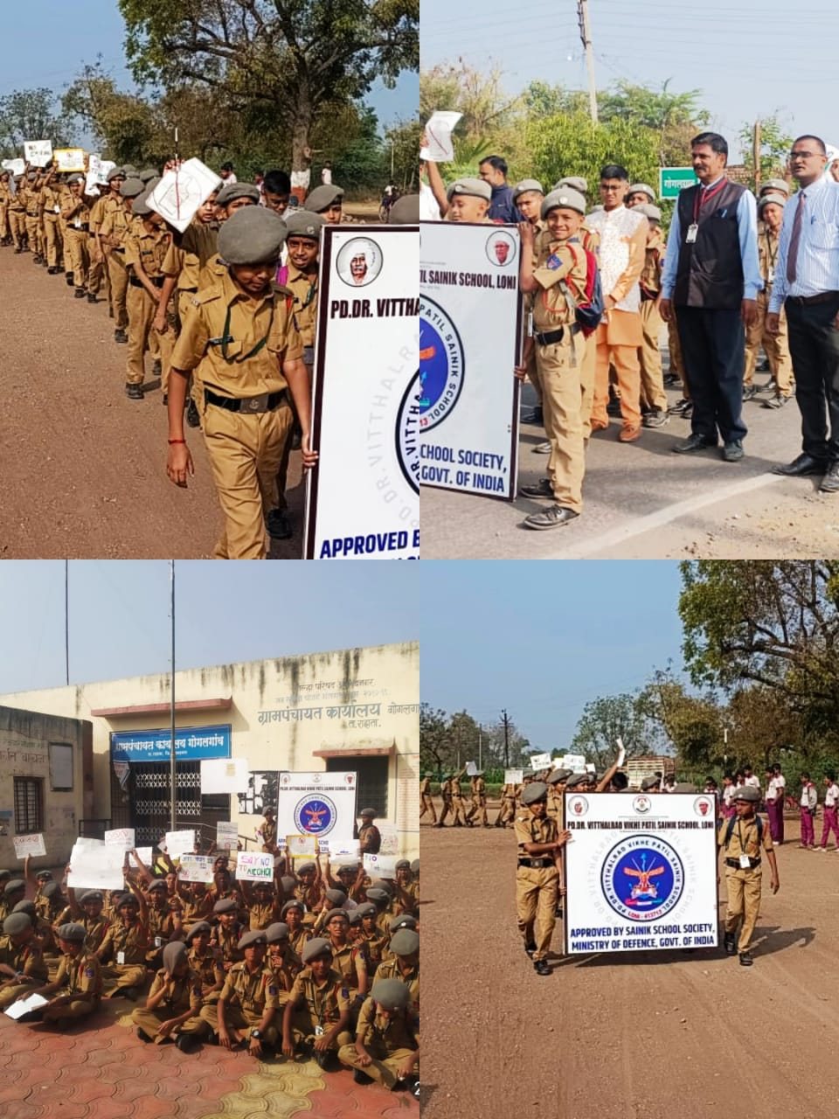
PADMASHRI DR. VITTHALRAO VIKHE PATIL SAINIK SCHOOL, LONI

Slide 3
PADMASHRI DR. VITTHALRAO VIKHE PATIL SAINIK SCHOOL, LONI

